Slide 1
Basic Foot Printing and Reconnaissance
By
Sunday Ologbo John
NCT/CS/25/0795

Slide 2
Objective
Demonstrate basic foot printing & reconnaissance on a domain
Use common tools: WHOIS, nslookup, Nmap, theHarvester
Show how to gather OSINT, DNS records, and open ports

Slide 3
Skills Learned
OSINT (open-source intelligence)
DNS enumeration (gathering DNS records)
Network scanning (finding open ports & services)

Slide 4
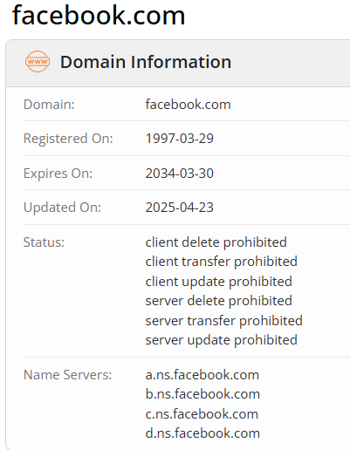
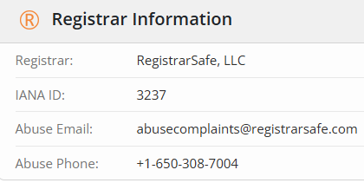
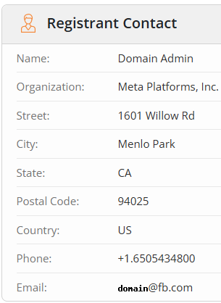
WHOIS
Domain registration & ownership info

Slide 5
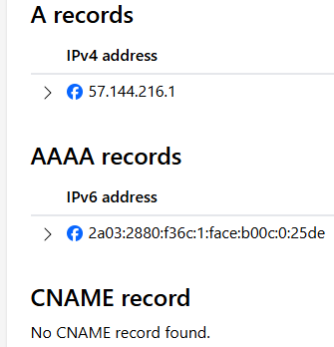
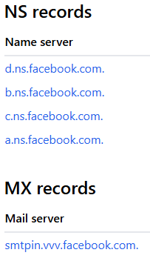
NSLOOKUP
DNS records: A, MX, NS

Slide 6
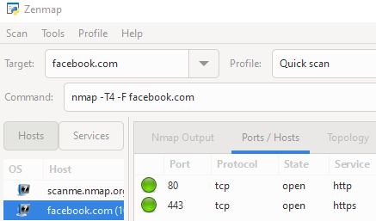
Nmap
Port scanning & service detection

Slide 7
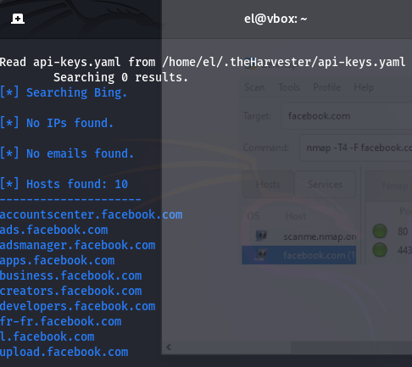
theHarvester
Purpose Gather emails & Subdomains

Slide 8
Tables of Findings
Tool | Key Findings | Why It Matters
WHOIS | Registrar: MarkMonitor, privacy protection enabled, domain registered long-term. | Prevents attackers from easily identifying ownership; shows strong asset control.
NSLOOKUP | Multiple IPs and DNS records, load balancing across global infrastructure. | Increases availability and resilience; harder for attackers to target a single host.
Nmap | Only standard ports 80 (HTTP) and 443 (HTTPS) open; SSL/TLS in use. | Minimal attack surface exposed; industry best practice for web-facing services.
theHarvester | Minimal results; few subdomains/contacts, most data scrubbed by security team. | Shows active footprint management, but demonstrates OSINT can still reveal traces.

Slide 9
Summary
Reconnaissance revealed only essential services exposed (HTTP/HTTPS).
WHOIS and DNS records show strong registration and global infrastructure.
Minimal OSINT data available due to active footprint management.
Overall: Facebook demonstrates a mature, hardened security posture.

Slide 10
Ethics
Reconnaissance should only be performed on systems you own or have permission to test.
Unauthorized scanning is considered illegal activity under cybersecurity laws.
Purpose of this exercise: education & defense, not exploitation.
Ethical hacking ensures organizations can fix weaknesses before attackers exploit them.

Slide 11
Recommendations / Next Steps
Continue limiting exposed services → Keep attack surface minimal.
Ongoing monitoring → Detect new subdomains, DNS changes, leaked assets.
Regular vulnerability assessments & penetration tests → Catch misconfigurations
before attackers do.
Strengthen OSINT hygiene → Reduce metadata leaks, enforce strict public-facing policies.
Incident response readiness → Ensure rapid response if anomalies or exposures are detected.

Slide 12

Closing
Thank You
Basic Footprinting & Reconnaissance Group 1

